Slide 1
ENTITY RELATIONSHIP MODELS 14 DEC 2021
TEAM 4 Blake, Jake and Chris

Slide 2
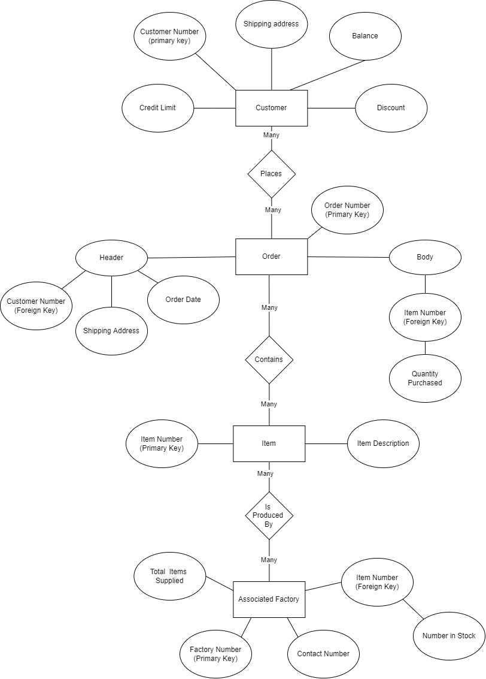

Slide 3
